Slide 1


Team Diaosi
Team members
Daoyuan Chen Haopeng Hu
CS-513A CS-513A
Graduate Graduate
Computer Science Computer Science

Slide 2
What is our goal?
Developing a classification model(s) to predict the potential of employees leaving the company (become terminated).
Applied models
KNN
Naive Bayes
CART
C50
ANN
Random Forest

Slide 3
Data Preprocessing
1.Convert the data type of "JOBCODE" from "numeric" to "factor”
2. Replace all "" with a random ethnicity in "ETHNICITY”
3. Replace all "" with "Unknown” in "REFERRAL_SOURCE” and remove "" level from "REFERRAL_SOURCE”
4. Convert the data type of "REHIRE" from "logical" to "factor"
5. Use 30% test 70% training data

Slide 4
Predict STATUS using KNN
K-Nearest Neighbor Algorithm
K-Nearest Neighbor Algorithm is an example of instance-based learning where training set records are first stored.
And the classification of a new unclassified record is performed by comparing it to records in training set to most similar.
Finally, K-Nearest Neighbor Algorithm is used most often for classification, although it is also applicable to estimation and prediction tasks.

Slide 5


Predict STATUS using KNN
Set three models for K=3,K=5, K=10 {library(kknn)}
1.Model for K=3

Slide 6


Predict STATUS using KNN
2.Model for K=5

Slide 7


Predict STATUS using KNN
3.Model for K=10

Slide 8
Predict STATUS using KNN
Conclusion for the models of K=3,K=5, K=10
The error rate for K = 3, K = 5 ,K = 10 are closed, and k= 10 is the most accurate one, so the number K has a little influence with the accuracy of KNN’s Prediction.

Slide 9


Predict STATUS using Naive Bayes
library(e1071)
Model for Naive Bayes

Slide 10


Predict STATUS using CART
library(rpart) and library(rpart.plot)
Model for CART

Slide 11


Predict STATUS using C50
library(C50)
Model for C50

Slide 12
Predict STATUS using ANN
Model for ANN
For this model, because we ANN need all data are numeric type, So we need more data preprocessing as following.
Drop "EMP_ID" and "TERMINATION_YEAR"
Perform min-max scaling each numerical feature column to the range [0,1]
Perform one-hot encoding on each categorical feature column
Perform one-hot encoding on label column
Concatenate normalized numerical features and one-hot encoded categorical features into X and denote label by y

Slide 13
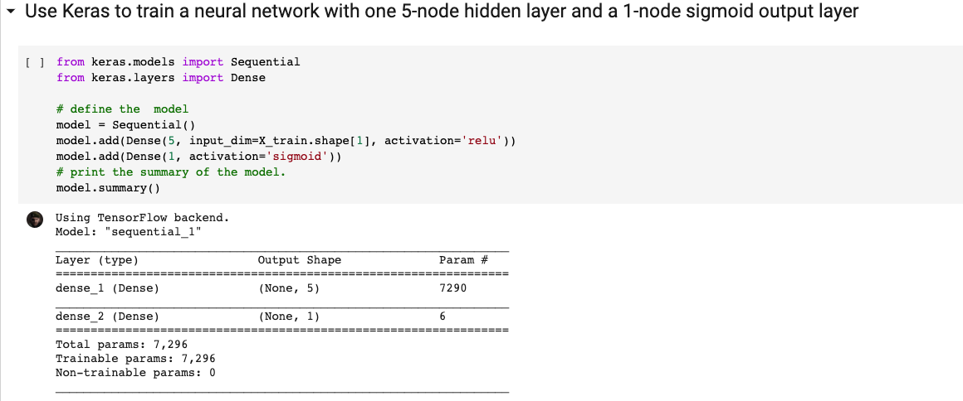
Predict STATUS using ANN
Then Use Keras to train a neural network with one 5-node hidden layer and a 1-node sigmoid output layer

Slide 14
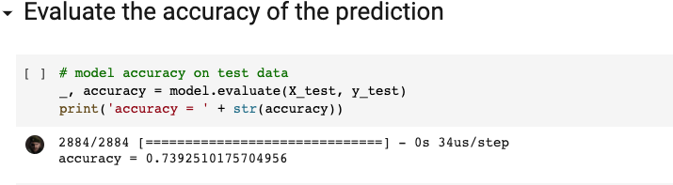
Predict STATUS using ANN
Finally Evaluate the accuracy of the prediction

Slide 15
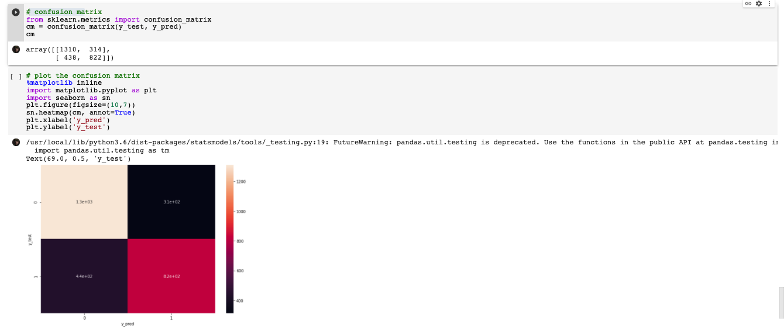
Predict STATUS using ANN
Build the confusion matrix and plot it(ANN model’s Prediction visible).

Slide 16
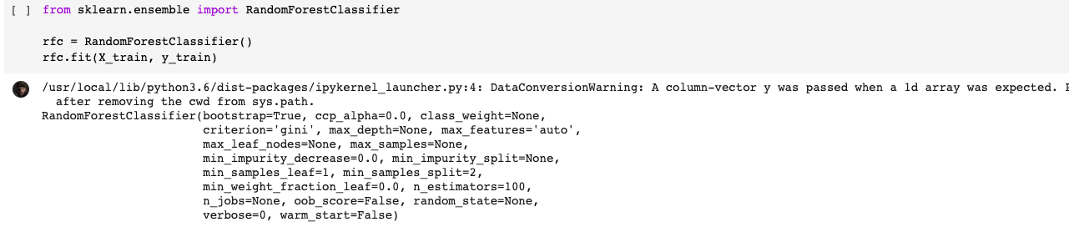
Predict STATUS using Random Forest
Model for Random Forest
For Random Forest Model, we must do some data preprocessing as same as ANN model.
Then we can build Random forest model to make a prediction.

Slide 17
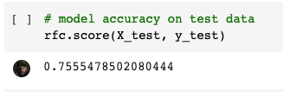
Predict STATUS using Random Forest
Finally Evaluate the accuracy of the prediction

Slide 18
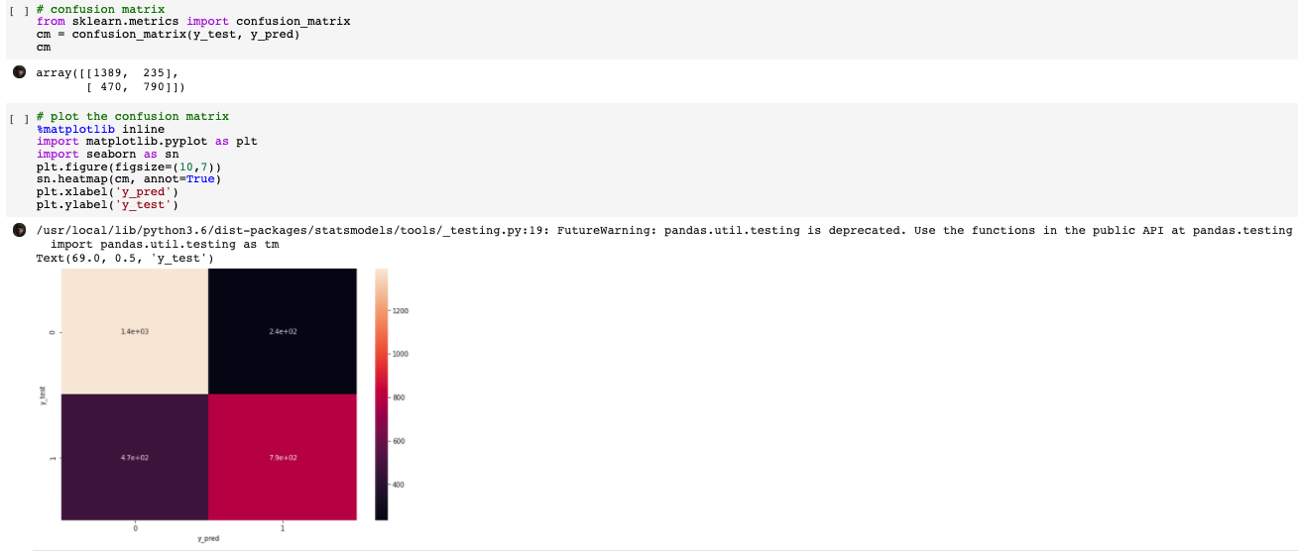
Predict STATUS using Random Forest
Build the confusion matrix and plot it(Random Forest model’s Prediction visible).

Slide 19
Conclusion
The error rate of KNN models are 0.3866158(K=3), 0.3863691(k=5), 0.3692788(K=10)
For Naive Bayes model the error rate is 0.350208.
For CART model(Decision-Tree) the error rate is 0.2676838
For C50 model(Decision-Tree) the error rate is 0.2479196 For Ann model, the error rate is around 0.26074898243.
For Random Forest model, the error rate is around 0.2444521498.
So the accurate order of each model is
Random Forest model, Ann model, C50 model and CART model’s accuracy are closed,
their accuracy are better than KNN models and Naive Bayes model .

